Slide 1
PART 2
DATABASE DESIGN

Slide 2
Extended ER Features

Slide 3
Extended E-R Features: Specialization
Top-down design process; we designate subgroupings within an entity set that are distinctive from other entities in the set.
The process of designating subgroupings within an entity set is called specialization.
These subgroupings become lower-level entity sets that have attributes or participate in relationships that do not apply to the higher-level entity set.
Depicted by a triangle component labeled ISA (E.g., instructor “is a” person).
Attribute inheritance – a lower-level entity set inherits all the attributes and relationship participation of the higher-level entity set to which it is linked.
Notes:
Example Person entity can be sub grouped as Student, Instructor and Non-teaching persons. Since they are having some special features.

Slide 4
In terms of an E-R diagram, specialization is depicted by a hollow arrow-head pointing from the specialized entity to the other entity (see Figure 7.21).
We refer to this relationship as the ISA relationship, which stands for “is a” and represents, for example, that an instructor “is a” employee.
For an overlapping specialization (as is the case for student and employee as specializations of person), two separate arrows are used.
For a disjoint specialization (as is the case for instructor and secretary as specializations of employee), a single arrow is used.

Slide 5
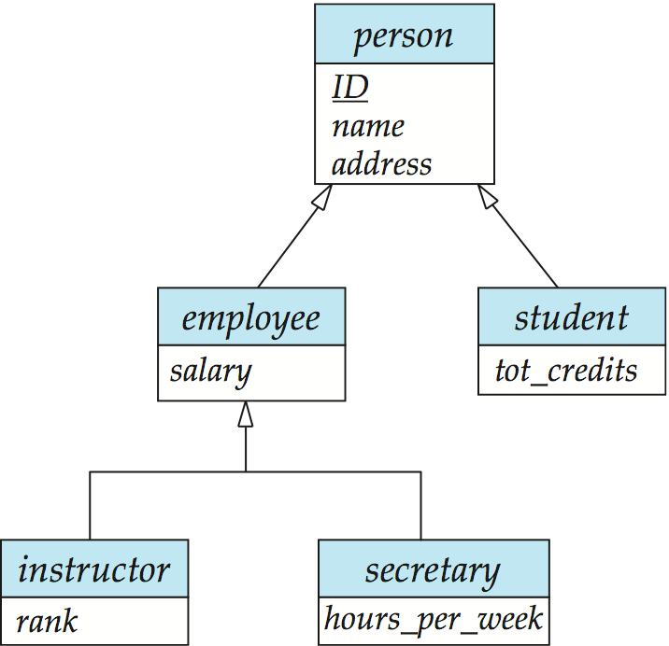
Specialization/Generalization Example
Advantage ?

Slide 6
Representing Specialization via Schemas
Method 1:
Form a schema for the higher-level entity
Form a schema for each lower-level entity set, include primary key of higher-level entity set and local attributes schema attributes person ID, name, street, city student ID, tot_cred employee ID, salary
Drawback: getting information about, an employee requires accessing two relations, the one corresponding to the low-level schema and the one corresponding to the high-level schema

Slide 7
Representing Specialization as Schemas (Cont.)
Method 2:
Form a schema for each entity set with all local and inherited attributes schema attributes person ID, name, street, city student ID, name, street, city, tot_cred employee ID, name, street, city, salary
If specialization is total, the schema for the generalized entity set (person) not required to store information
Can be defined as a “view” relation containing union of specialization relations
Drawback: name, street and city may be stored redundantly for people who are both students and employees

Slide 8
Extended ER Features: Generalization
A bottom-up design process – combine a number of entity sets that share the same features into a higher-level entity set.
Specialization and generalization are simple inversions of each other; they are represented in an E-R diagram in the same way.
The terms specialization and generalization are used interchangeably.

Slide 9
Specialization and Generalization (Cont.)
Can have multiple specializations of an entity set based on different features.
E.g., permanent_employee vs. temporary_employee, in addition to instructor vs. secretary
Each particular employee would be
a member of one of permanent_employee or temporary_employee,
and also a member of one of instructor, secretary
The ISA relationship also referred to as superclass - subclass relationship

Slide 10
Design Constraints on a Specialization/Generalization
Conditioned defined: membership evaluated on the basis of if the entity has satisfied the condition
User defined: designer assigns the entities

Slide 11
Design Constraints on a Specialization/Generalization
Constraint on whether or not entities may belong to more than one lower-level entity set within a single generalization.
Disjoint
an entity can belong to only one lower-level entity set
Noted in E-R diagram by having multiple lower-level entity sets link to the same triangle
Overlapping
an entity can belong to more than one lower-level entity set
Notes:
Constraint on which entities can be members of a given lower-level entity set.
condition-defined
Example: all customers over 65 years are members of senior-citizen entity set; senior-citizen ISA person.
user-defined

Slide 12
Specialization/Generalization Example
Advantage ?

Slide 13
Design Constraints on a Specialization/Generalization (Cont.)
Completeness constraint -- specifies whether or not an entity in the higher-level entity set must belong to at least one of the lower-level entity sets within a generalization.
total: an entity must belong to one of the lower-level entity sets
partial: an entity need not belong to one of the lower-level entity sets
Total: student must belong to either graduate or undergraduate
Example for partial:
Employee’s Subclass are S/W Engineers and Quality Engineers

Slide 14
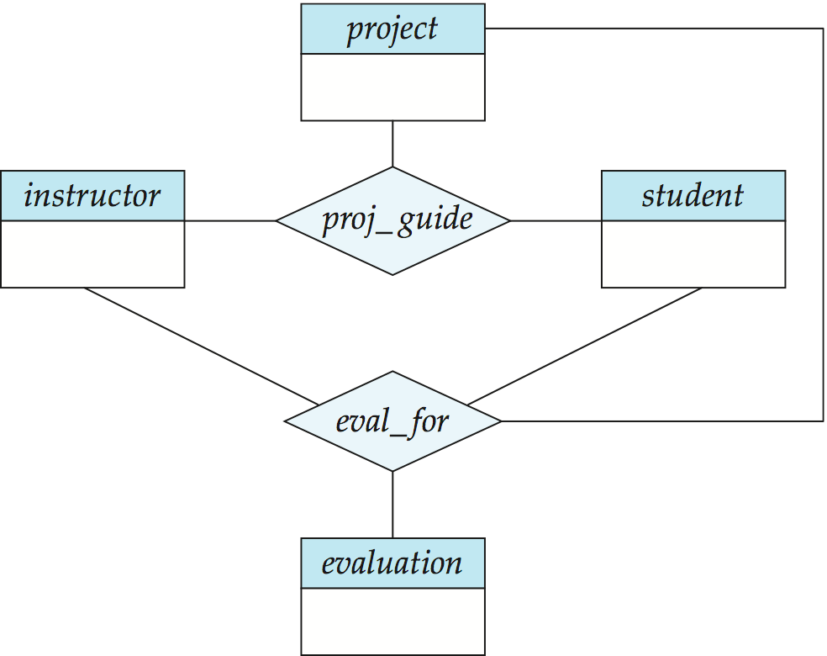
Aggregation
Consider the ternary relationship proj_guide, which we saw earlier
Suppose we want to record evaluations of a student by a guide on a project
Notes:
We may not be having evaluation for all the pro_guide relation instances

Slide 15
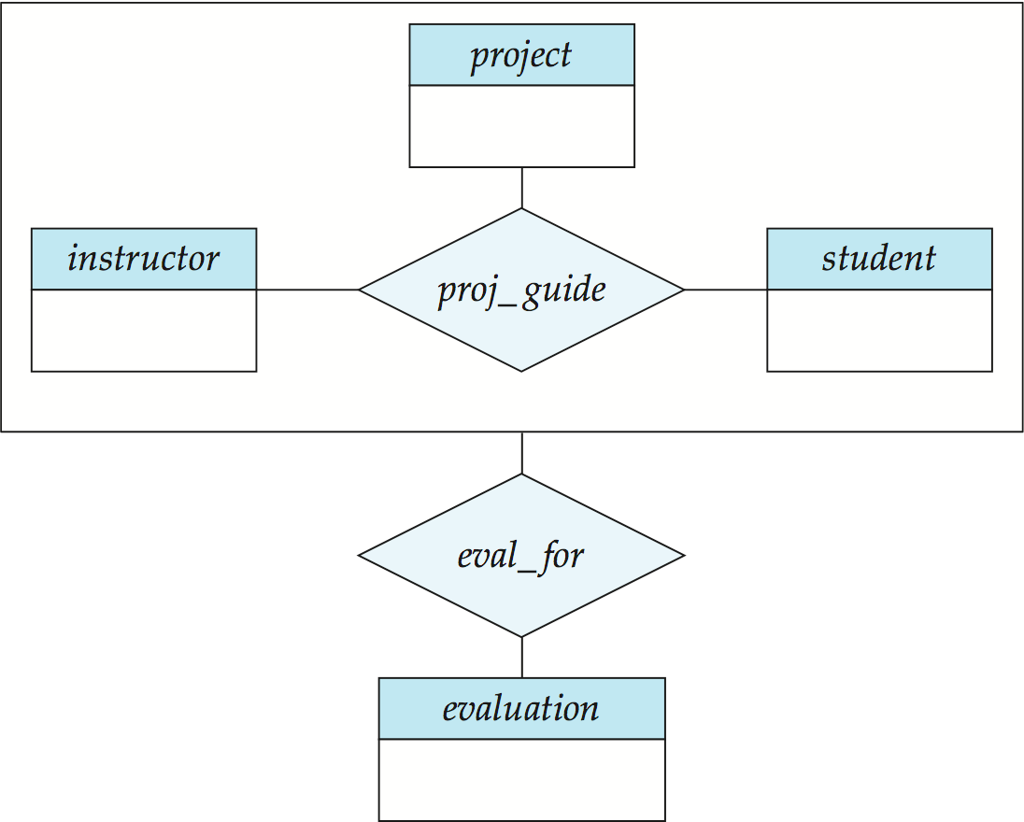
Aggregation (Cont.)
Without introducing redundancy, the following diagram represents:
A student is guided by a particular instructor on a particular project
A student, instructor, project combination may have an associated evaluation
Allows relationships between relationships
Abstract entity
Notes:
15

Slide 16
Aggregation is an abstraction through which relationships are treated
as higher-level entities. Thus the relationship between entities and is treated as if it were an entity .

Slide 17
Aggregation (Cont.)
Relationship sets eval_for and proj_guide represent overlapping information
Every eval_for relationship corresponds to a proj_guide relationship
However, some proj_guide relationships may not correspond to any eval_for relationships
So we can’t discard the proj_guide relationship
Eliminate this redundancy via aggregation
Treat relationship as an abstract entity
Allows relationships between relationships
Abstraction of relationship into new entity

Slide 18
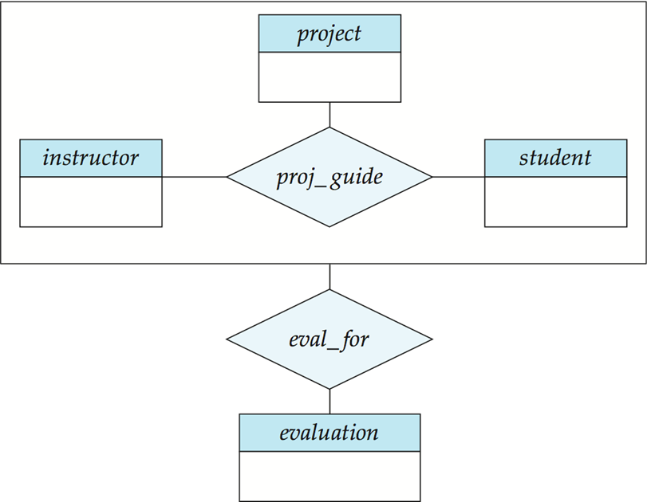
Schemas Corresponding to Aggregation
To represent aggregation, create a schema containing
primary key of the aggregated relationship,
the primary key of the associated entity set
any descriptive attributes
eval_for (s_ID, project_id, i_ID, evaluation_id)

Slide 19
Employees work for projects. An employee working for a particular project uses various machinery.

Slide 20
Manufacturers have tie-ups with distributors to distribute products. Each tie-up has specified for it the set of products which are to be distributed.

